Slide 2

An insurance company for working life
2

Slide 3


9 out of 10 Swedish employees are covered
5,4 million employees are covered by collectively agreed insurance policies
Private companies 3 550 000
Municipalities and country councils 1 500 000
Governmental organisations 350 000

Slide 4
Our history

Slide 5
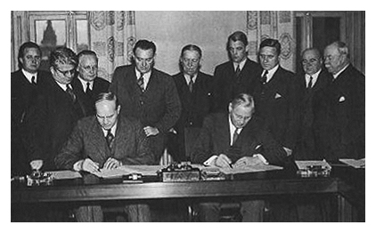
The historic agreement
In 1938, the first framework agreement, the Saltsjöbaden Agreement, was signed between the labour market parties.
The Saltsjöbaden Agreement is the foundation of the Swedish model.
It regulates, among other things, negotiation procedures, dismissal of employees, and economic industrial action.
25 years later, in 1963, the first insurance policy was born.

Slide 6

A safety net for widows
The first collectively agreed insurance came into force in January 1963.
The labour market parties agreed on a life insurance policy for a vulnerable group – the widows.
Arbetsmarknadens Försäkrings- aktiebolag, AFA, was founded.

Slide 7

Collective agreements, the Swedish model – and the advantages of collectively agreed insurance policies

Slide 8
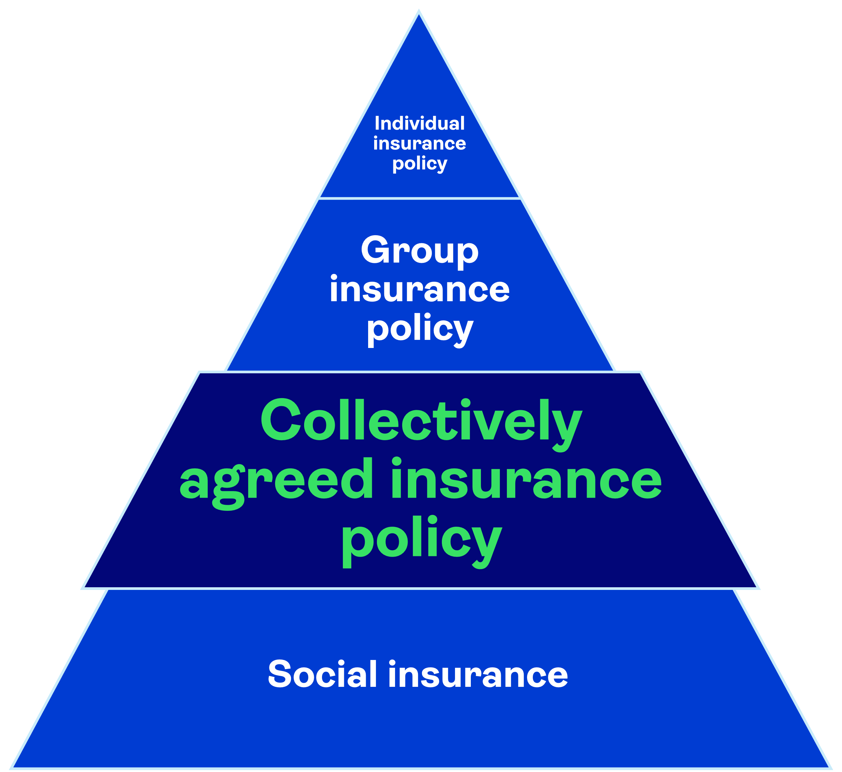
What is a collective agreement?
A written agreement between trade union associations and employers’ associations or individual employers.
An agreement which regulates salaries and other employment conditions.
Agreements adapted for industry, company or workplace.

Slide 9

We make sure people can have a safer everyday life
You are automatically covered by virtue of your employment.
The employer pays the premium.
Everyone who is entitled to compensation will receive it.
We make the claims process easy.
Our claims adjustment is active and outreaching.

Slide 10

About Afa Försäkring

Slide 11
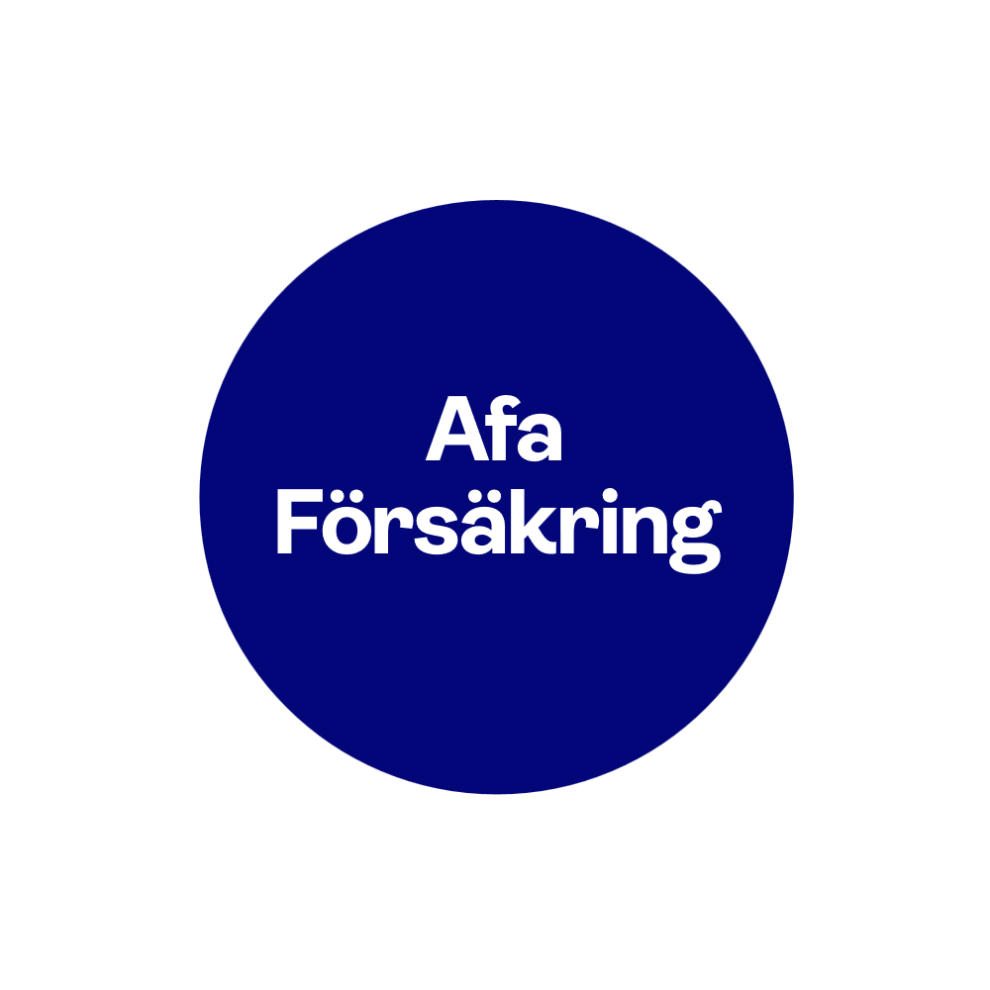
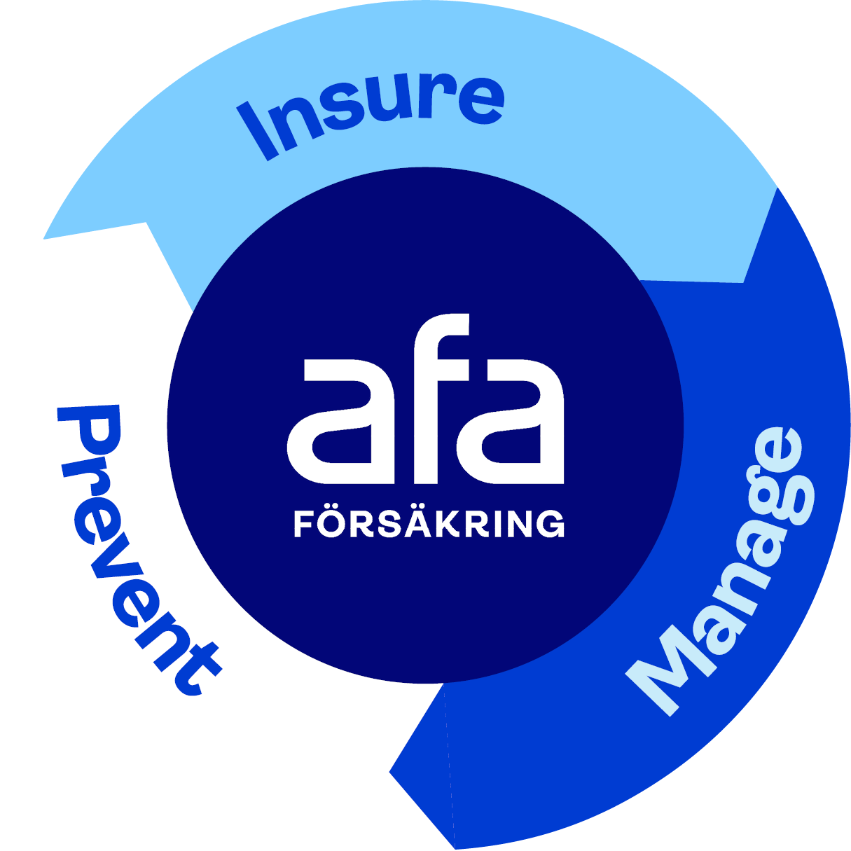
What we do

Slide 12
Organisation
CEO
Central functions:
Actuarial function
Risk control
Regulatory compliancy
Internal audit
Actuary
Finance
Human Resources
Legal affairs
Strategy and communication
IT
Claims adjustment
Asset management
Prevention
12

Slide 13



Our owners
50 %
46,43 %
3,57 %
Afa Försäkring tjänstepensionsaktiebolag

Slide 14
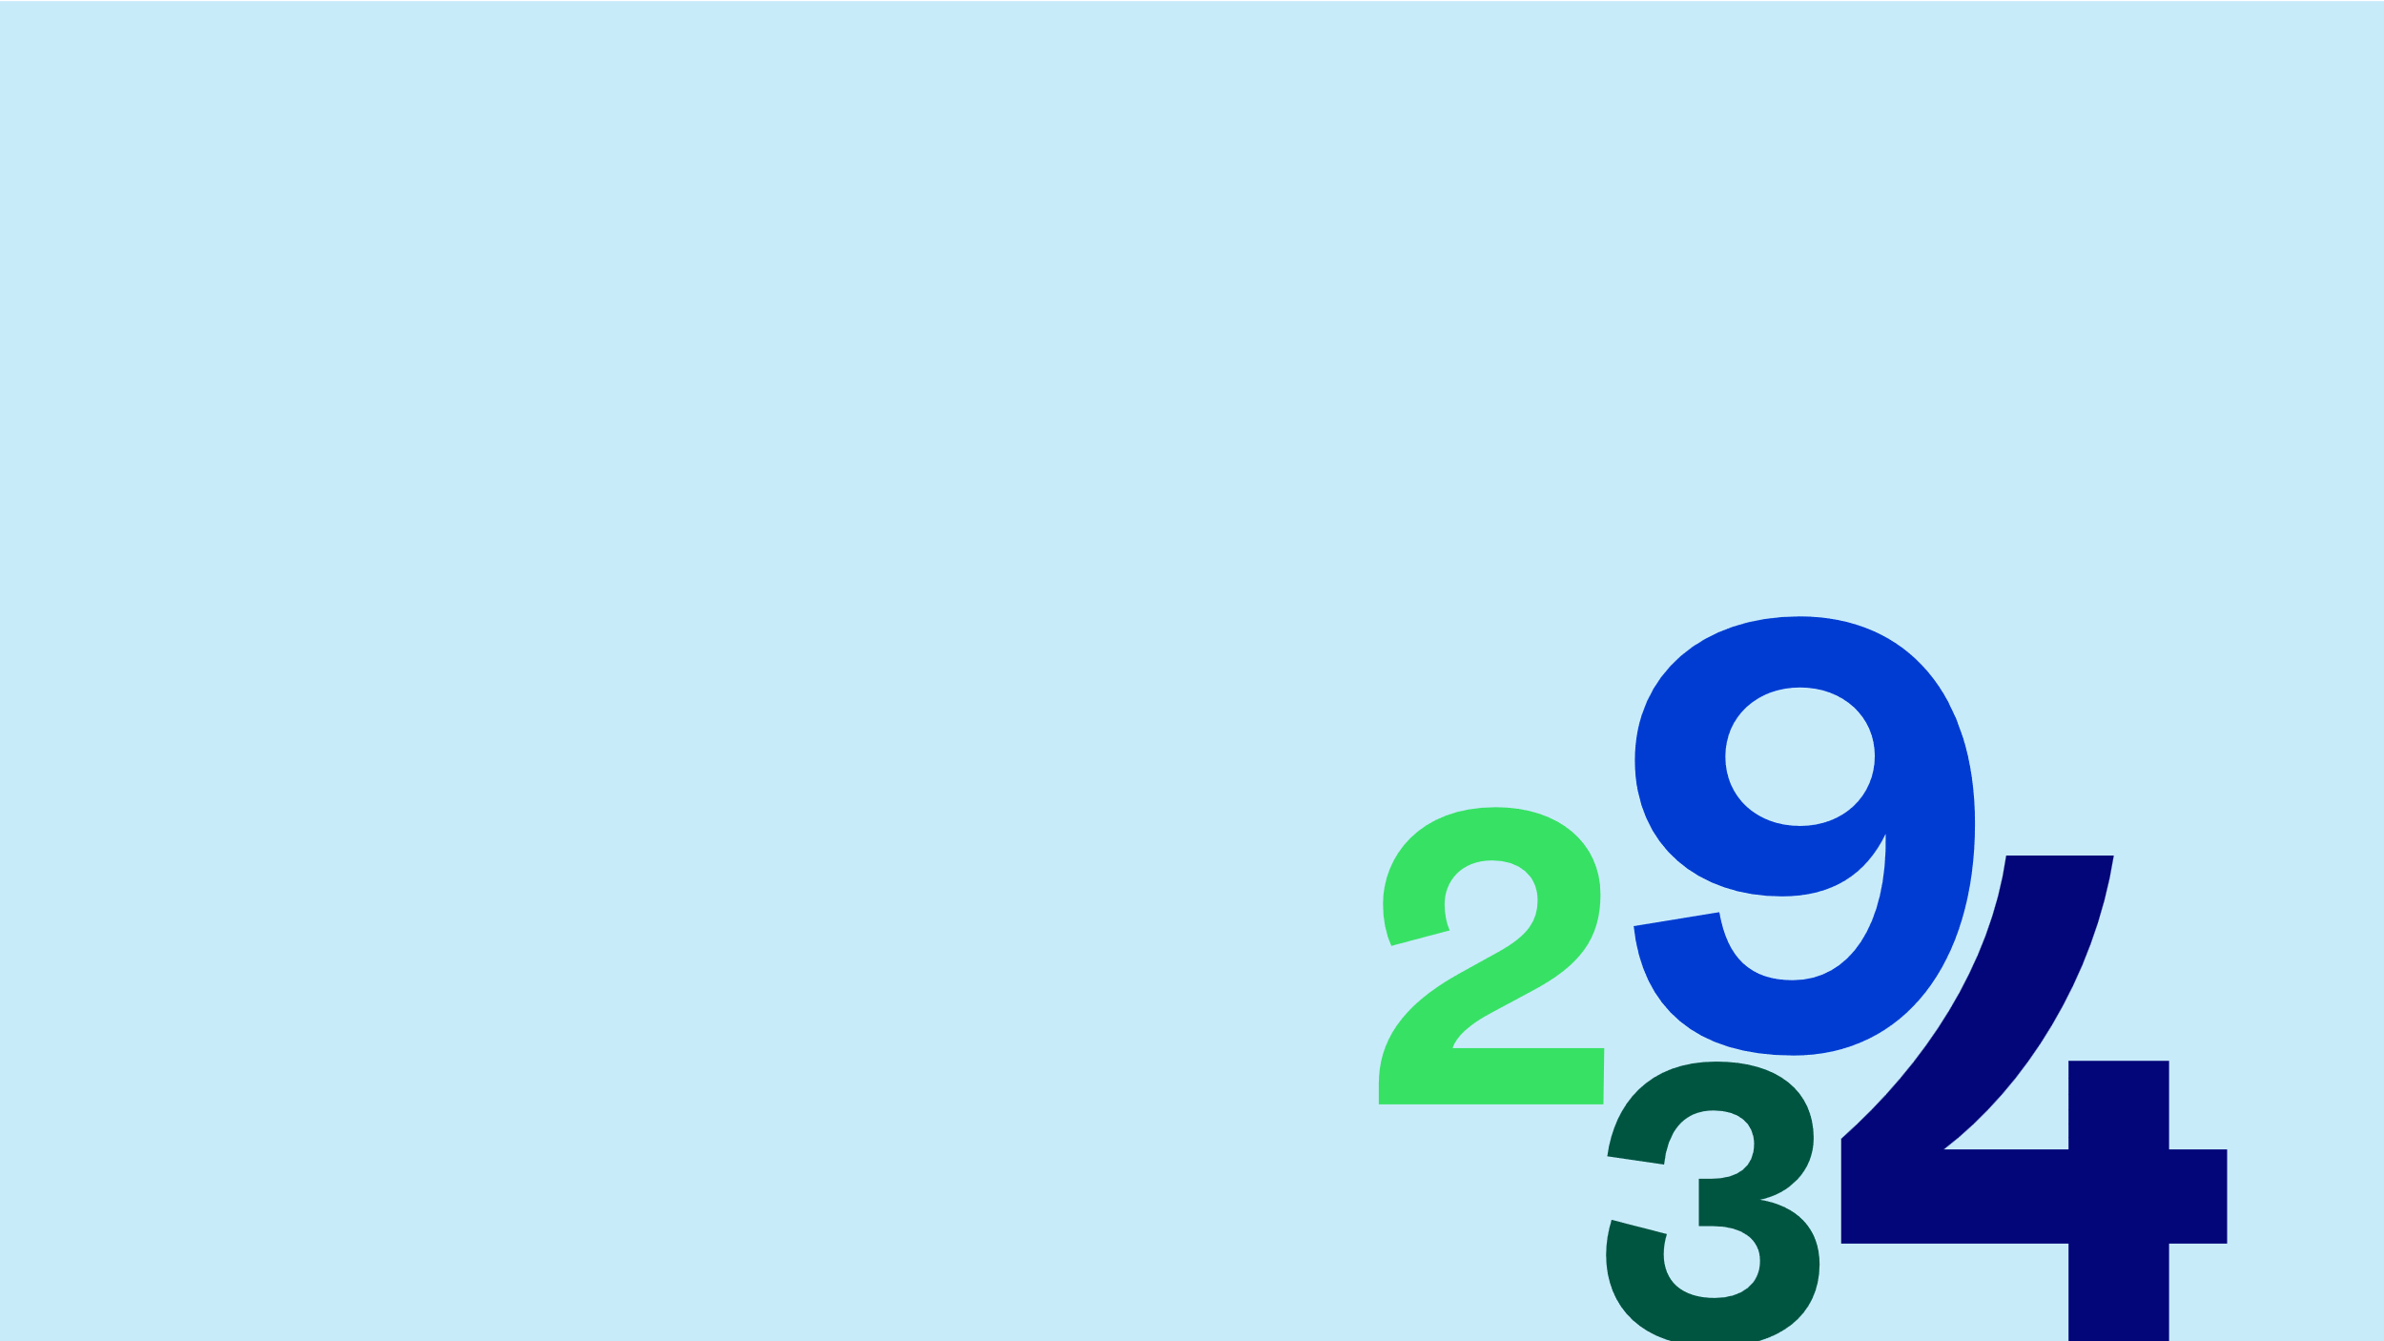
Our business figures 2025–2026
5.4 million people insured.
SEK 1.4 billion in premium revenue.
SEK 43 billion in premium paid back for 2004–2008.
SEK 9.7 billion in compensation paid out .
336 000 new cases.
17 million cases since beginning of the 1970’s.
SEK 207 billion in assets under management.
SEK 157 million in research funding year 2025.
783 employees.

Slide 15

Our customers are satisfied
We conduct surveys on a regular basis.
We measure the Customer Satisfaction Index (CSI).
Our customer satisfaction is higher than the average for the industry.
One success factor is the good relationship between the customer, and the insurance claims handler.
Customer Satisfaction Index for 2025 = 76 of 100.

Slide 16

A long-term and sustainable business model

Slide 17

Financial sustainability
Cost-effective operations.
Safe and stable asset management.
Managing about 207 billion SEK.
Ethical and environmental requirements.
Long-term perspective, and good value growth.
Maximised return at a low cost.
No profit motive.

Slide 18

Environmental sustainability
Climate-smart energy choices.
Electricity labeled with ”good environmental choice”.
Electronic invoice processing.
Online insurance claim applications.
Best environmental choices for travel and transport.

Slide 19

Social sustainability
Safety at work for all Swedish employees.
No one shall miss the compensation they are entitled to.
9.7 billion in insurance compensations in 2025.
Customer satisfaction.
Effortless for the customers.
One of Sweden’s biggest research financiers within the work environment area, with 157 million SEK in 2025.

Slide 20

Financial performance and key facts Asset Management Division

Slide 21
Key financial facts in 2025
SEK 207 billion in assets under management.
SEK 1.4 billion in premium income.
SEK 9.7 billion in insurance claims paid out.
SEK 11.2 billion in total return on investments .
Average 7,7 % return per annum over 10 years, 2013–2022.

Slide 22
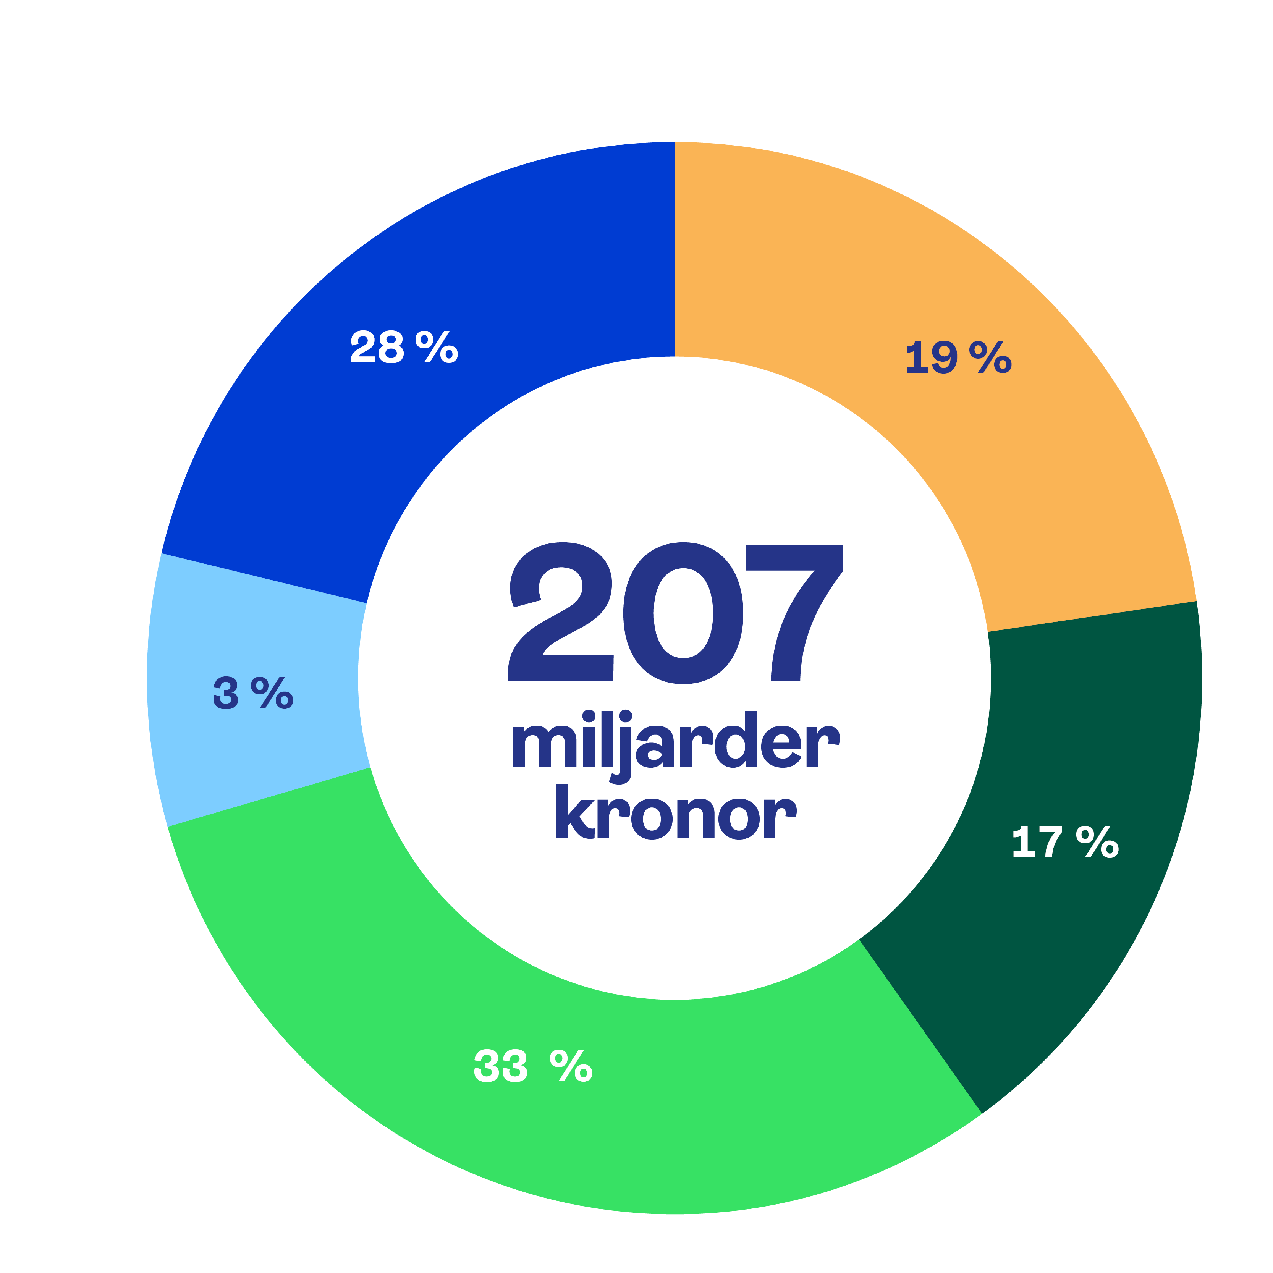
Brief description of Afa Insurance and the asset management division 2025
Assets under management per asset class 2025-12-31
Owned by the Confederation of Swedish Regulated as an occupational pension company under IORP II.
Under supervision of the Swedish FSA (Finansinspektionen).
SEK 207 billion in AUM.
Five major asset classes.
About 80 % of assets managed in-house.
Enterprise (Svenskt Näringsliv, the Swedish Trade Union Confederation (LO) and the Swedish Council for Negotiation and Co-operation (PTK).
Fixed income nominal
Alternative
investments
SEK
Fixed income
(index linked bonds)
207 billion
Real estate
assets
Equities
22

Slide 23
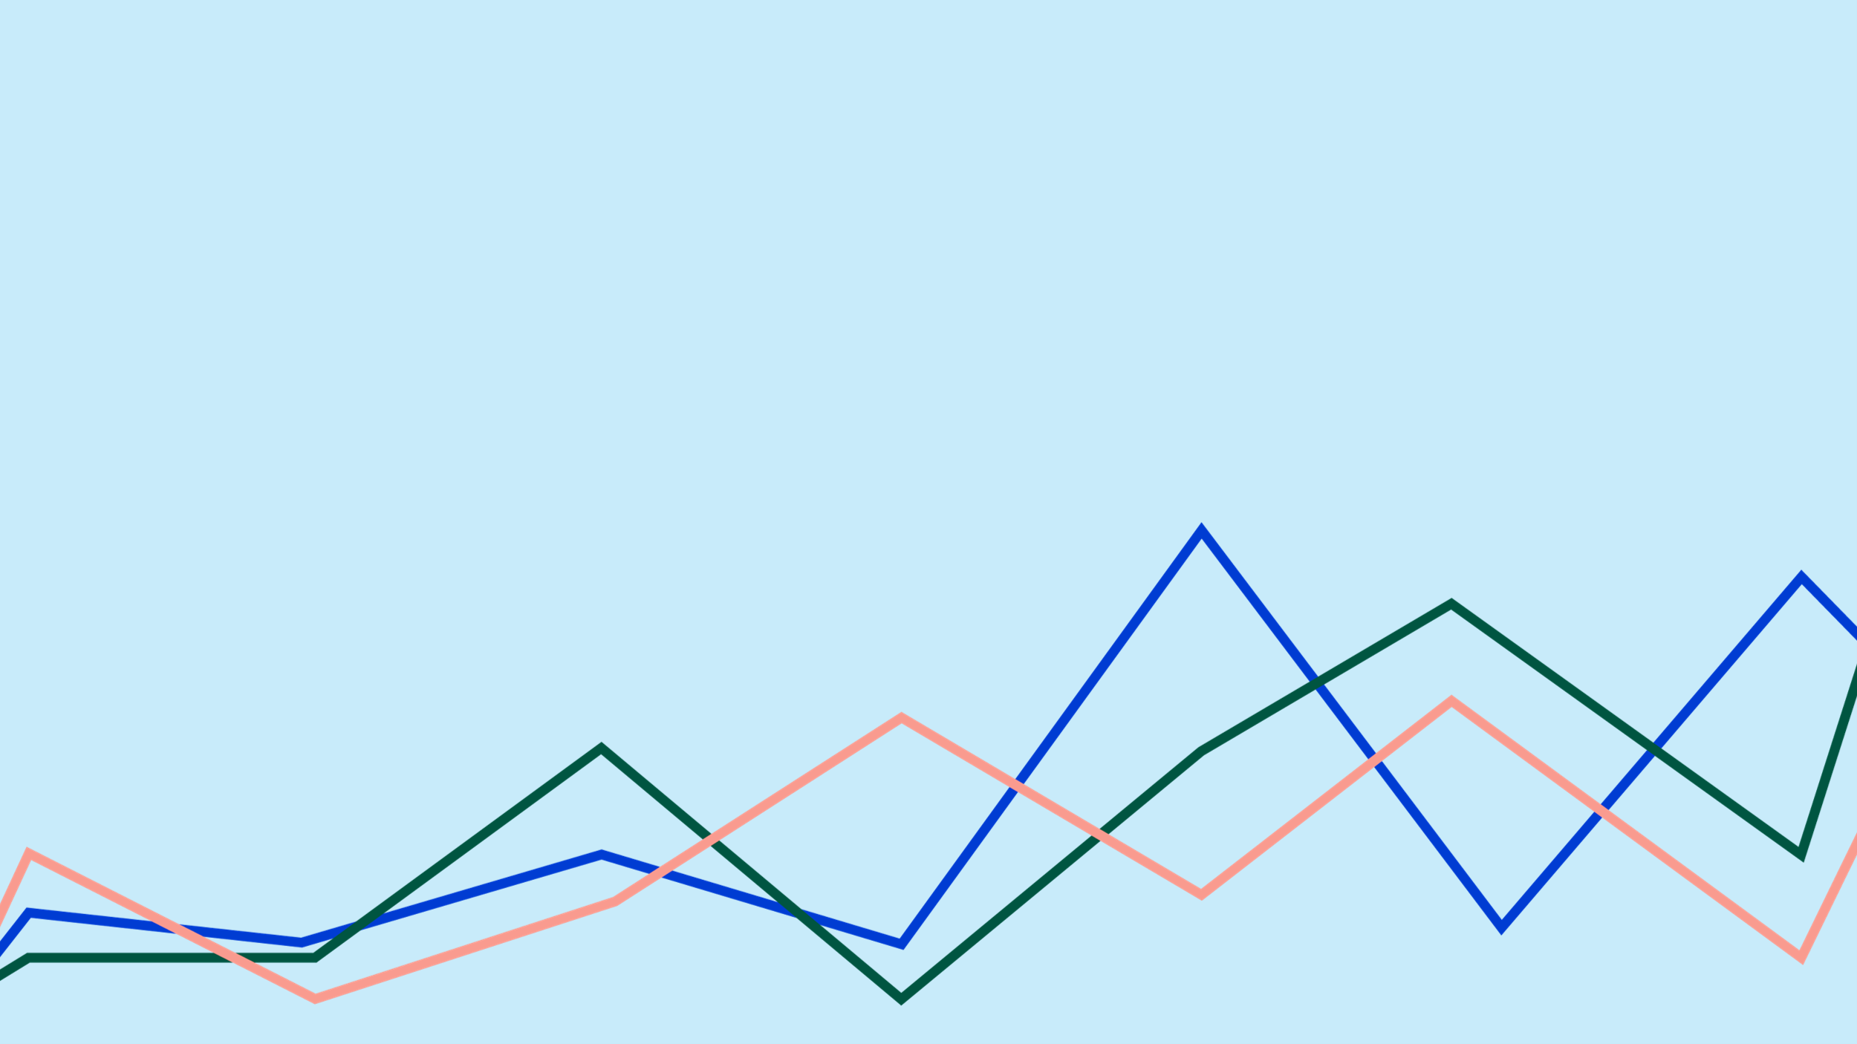
Key operational figures in 2025–2026
About 150 million in medical research grants per annum
783 employees
About 5.4 million individuals covered by our insurance contracts
336 000 new insurance claims
SEK 1.4 billion in premium income
About SEK 9.7 billion in insurance claims paid out

Slide 24

Insurances

Slide 25





Insurances during working life
Illness
Work injury
Lay-off due lack of work
Death
Parental leave
Group sickness insurance (AGS/ AGS-KL) Waiver of contribution insurance Waiver of premium insurance
Work injury insurance (TFA/TFA-KL) Compensation for personal injury agreement (PSA) Waiver of contribution insurance Waiver of premium insurance
Group life insurance (TGL)
Supplementary parental benefit insurance Waiver of premium insurance
Severance payment insurance (AGB)

Slide 26

Preventive actions – to improve workplace health and safety

Slide 27
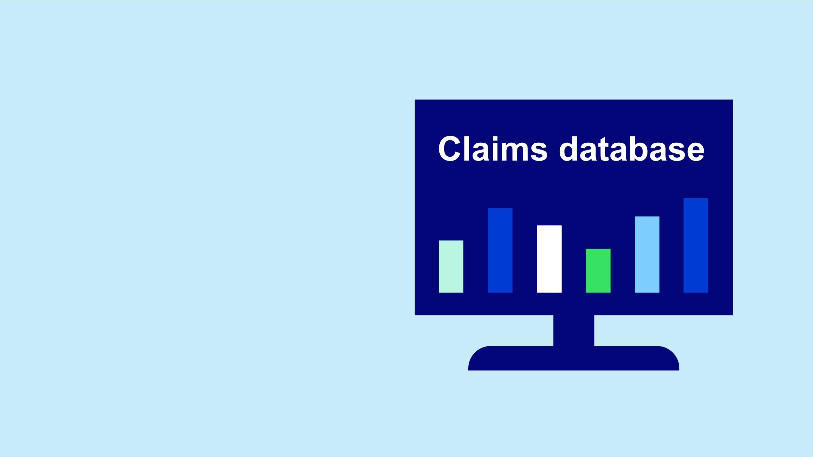
Unique claims database
17 million insurance claims in the claims database.
Statistical reports on occupation injuries and sick leave.
A decision-making basis for research projects and preventive initiatives.

Slide 28
Research and development
We provide financial support for research which aims to improve workplace health and safety.
SEK 157 million for research into occupational health and safety 2025.
Based on the statistics of injuries.
The R&D projects are expected to improve workplace health and safety.
28

Slide 29

IA System support
Web-based reporting tool.
Supports systematic work environment management.
For reporting and following up incidents and risks in workplaces.
More than 1.8 million people work at companies that use IA.

Slide 30

Rehabilitation support
Financial support to employers.
Preventive actions and support for returning to work.
For employees who have our health insurance.
Vocational rehabilitation.

Slide 31

Support for training in workplace health and safety
Financial support to employers.
Promotes shared training among managers and health and safety representatives.
Improved dialogue and knowledge of health and safety activities in the workplace.

Slide 32

More preventive actions
Workplace health and safety conference Gilla Jobbet.
Supported the Construction safety training park – training facility for construction employees to practise safe working.
Previous collaborative initiative with the Swedish Judo Federation to prevent and reduce injuries from falls.

